Slide 1
Cryptography of Blockchains
CSCI-GA 3033-107
https://brightspace.nyu.edu/d2l/home/353819
Benedikt Bünz
New York University
[discussion on brightspace]
[first homework – coming soon]

Slide 2
What is a blockchain for?
Abstract answer: a blockchain provides
coordination between many parties,
when there is no single trusted party
if trusted party exists ⇒ no need for a blockchain
Notes:
but blockchains also used in other areas, like digital asset management, e.g., as in online games.

Slide 3
What is a blockchain?
Abstract answer: a blockchain provides
coordination between many parties,
when there is no single trusted party
if trusted party exists ⇒ no need for a blockchain
[financial systems: often no trusted party]
Notes:
but blockchains also used in other areas, like digital asset management, e.g., as in online games.

Slide 4
Blockchains: what is the new idea?
2009
Bitcoin
Several innovations:
A practical public append-only data structure, secured by replication and incentives
A fixed supply asset (BTC). Digital payments, and more.

Slide 5
Blockchains: what is the new idea?
2009
2015
Bitcoin
Ethereum
Several innovations:
Blockchain computer: a fully programmable environment
⟹ public programs that manage digital and financial assets
Composability: applications running on chain can call each other

Slide 6
Blockchains: what is the new idea?
2009
2015
2017
2024
Bitcoin
Ethereum
growth of DeFi, NFTs, DAOs

Slide 7
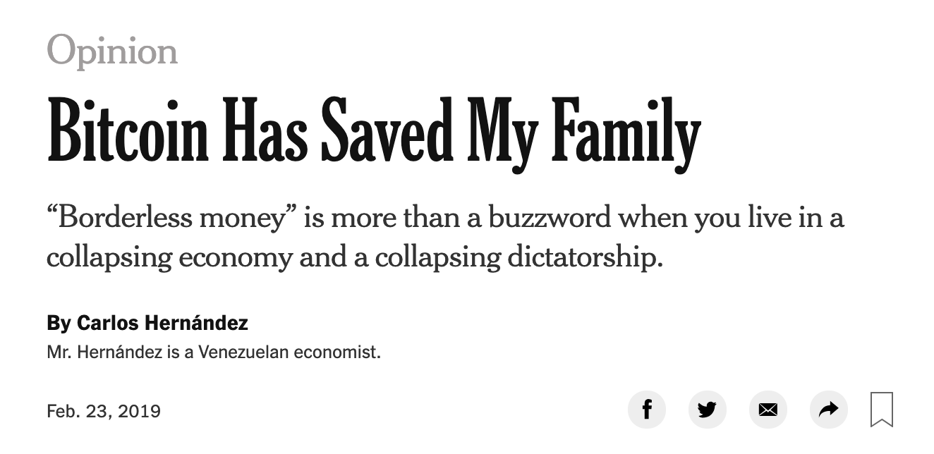


So what is this good for?
(1) Basic application: a digital currency (stored value)
Current largest: Bitcoin (2009), Ethereum (2015)
Global: accessible to anyone with an Internet connection

Slide 8
What else is it good for?
(2) Decentralized applications (DAPPs)
DeFi: financial instruments managed by public programs
examples: stablecoins, lending, exchanges, ….
Asset management (NFTs): art, game assets, domain names.
Decentralized organizations (DAOs): (decentralized governance)
DAOs for investment, for donations, for collecting art, etc.
(3) New programming model: writing decentralized programs

Slide 9
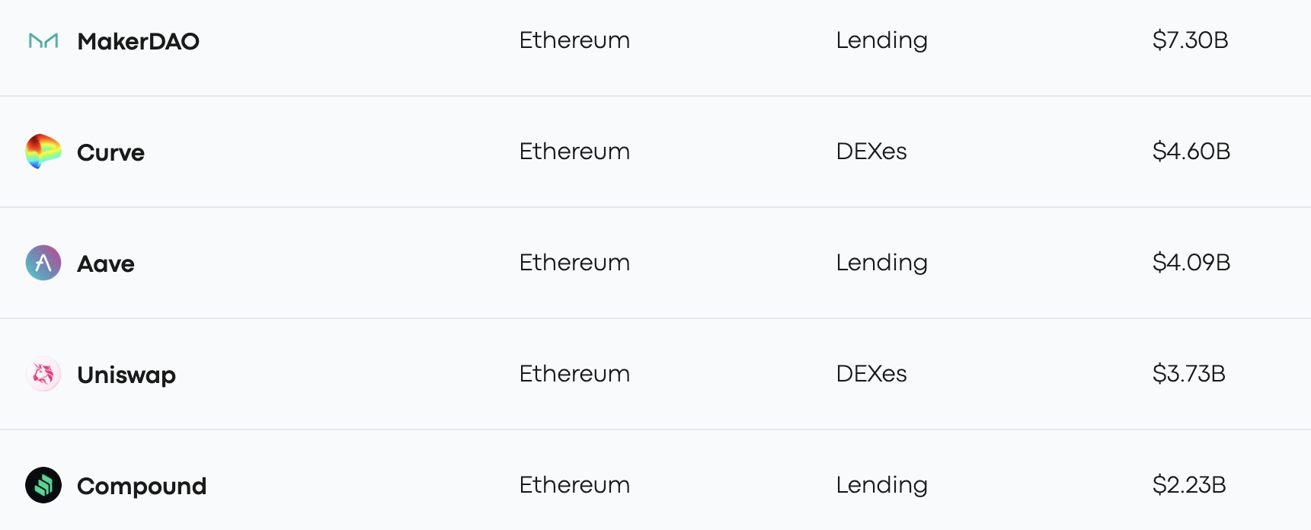
Assets managed by DAPPs
StableCoin
$4.5B
Exchange
$2.2B
V3
Lending
$2.3B
V3
Exchange
$3.1B
Lending
$1.8B
Sep. 2023

Slide 10
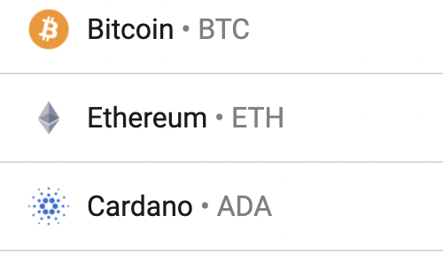
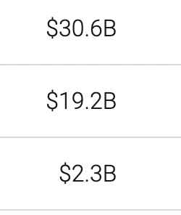
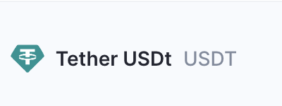

Transaction volume
24h volume Jan. 2024
$10.5B
$5.1B
$23.5B

Slide 11
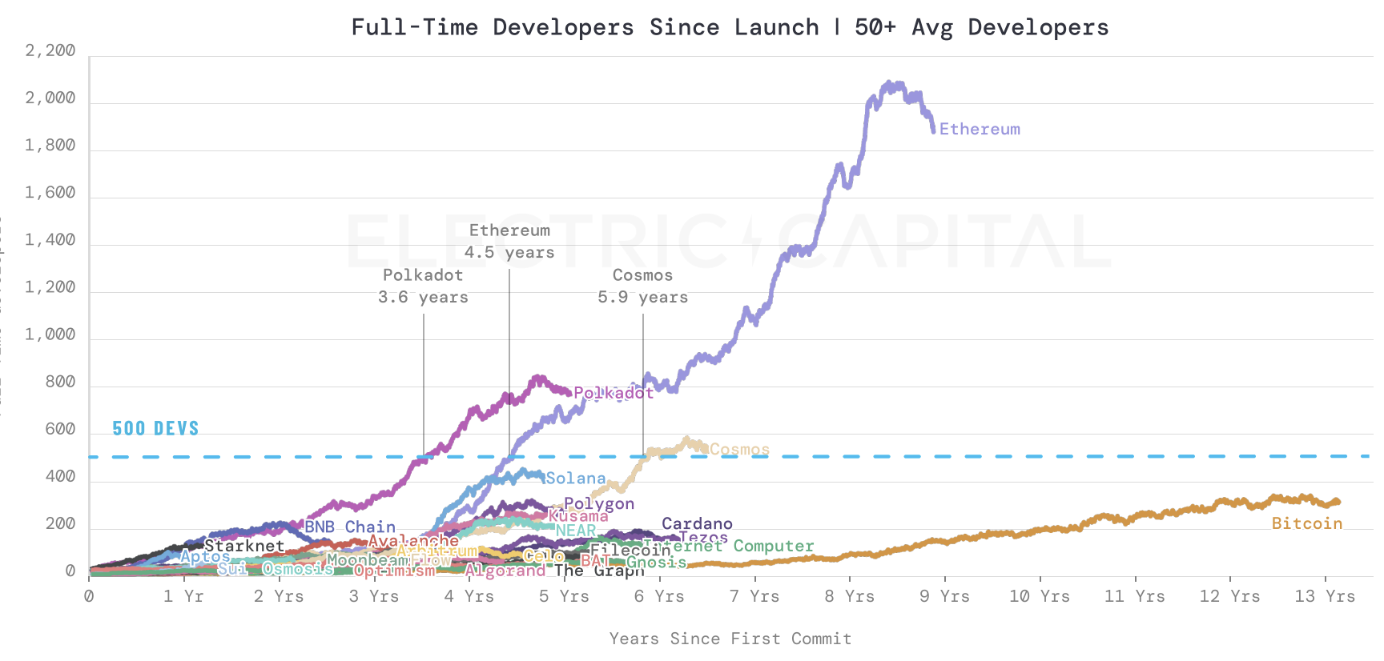
# Active developers since launch (as of 12/31/2023)
source: electric capital
Notes:
https://github.com/electric-capital/developer-reports/blob/master/dev_report_2022.pdf

Slide 12


What is a blockchain?
user facing tools (cloud servers)
applications (DAPPs, smart contracts)
Execution engine (blockchain computer)
Consensus/Sequencer: orders transactions
Cryptography
is everywhere
Data (Availability) Layer

Slide 13
Cryptography in Blockchains
Ensure transactions are authenticated (Signatures)
Facilitate fast/secure consensus (Beacons/Aggregation)
Outsource Execution (SNARKs)
Enable private transactions (Zero Knowledge)
Securely distributed and back up keys (Threshold Crypto)
And much more…
This course studies the Cryptography in Blockchains and its applications

Slide 14
Let’s dive in

Slide 15
Consensus layer (informal)
achieved by replication
A public append-only data structure:
Persistence: once added, data can never be removed*
Safety: all honest participants have the same data**
Liveness: honest participants can add new transactions
Open(?): anyone can add data (no authentication)
Data Availability / Consensus layer
Notes:
[Pass, Seeman, Shelat, 2016]
Blockchain data needs to be public: private blockchains are not part of this course.

Slide 16
How are blocks added to chain?
blockchain
signed
I am the leader
6.25 BTC
sk_{A}
verify
block
verify
block
sk_{B}
sk_{C}

Slide 17
How are blocks added to chain?
blockchain
…
6.25 BTC
I am the leader
sk_{A}
sk_{B}
6.25 BTC
sk_{C}
Notes:
Like a cloud service paid for by inflation.

Slide 18
Why is consensus a hard problem?
Tx1, Tx2, Tx3, Tx4
Tx1, Tx2, Tx3, Tx4
Tx1
Tx3
The good case: copies are consistent
Tx2
Tx4
Tx1, Tx2, Tx3, Tx4
Tx1, Tx2, Tx3, Tx4

Slide 19
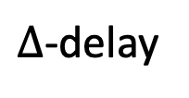
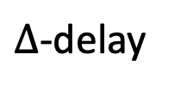
Why is consensus a hard problem?
Tx1, Tx2, Tx3, Tx4
Tx3, Tx4, Tx1, Tx2
Tx1
$∆$-delay
Tx3
Problems:
Network delays
can affect Tx order
Tx2
Tx4
$∆$-delay
Tx1, Tx2, Tx4, Tx3
Tx4, Tx3, Tx1, Tx2
Notes:
In case of network partition: can stop accepting transactions (Paxos), or can accept transactions and resolve fork once partition heals (Bitcoin).

Slide 20

Why is consensus a hard problem?
Tx1, Tx2
Tx3, Tx4
Tx1
Tx3
Problems:
Network delays
Network partition
network
partition
Tx2
Tx4
Tx1, Tx2
Tx3, Tx4
Notes:
In case of network partition: can stop accepting transactions (Paxos), or can accept transactions and resolve fork once partition heals (Bitcoin).

Slide 21
Why is consensus a hard problem?
Tx1, Tx2, Tx4
crashed
Tx1
Tx3??
Problems:
crash
Tx2
Tx4
Tx1, Tx2, Tx4
Tx1, Tx2, Tx4
Notes:
Goal: security when 51% of nodes are honest.

Slide 22

Why is consensus a hard problem?
???
Tx1
Problems:
crash
malice
Consensus protocols:
Later in the course
Tx2
Tx4
???
???
Notes:
Goal: security when 51% of nodes are honest.

Slide 23
Next layer: the blockchain computer
Decentralized applications (DAPPs):
Run on blockchain: code and state are written on chain
Accept Tx from users ⇒ state transitions are recorded on chain
blockchain computer
DAPP
DAPP
DAPP
on-chain state
Data availability / Consensus layer

Slide 24
Next layer: the blockchain computer
Top layer: user facing servers
end user
blockchain computer
DAPP
DAPP
DAPP
on-chain state
Data availability / Consensus layer

Slide 25
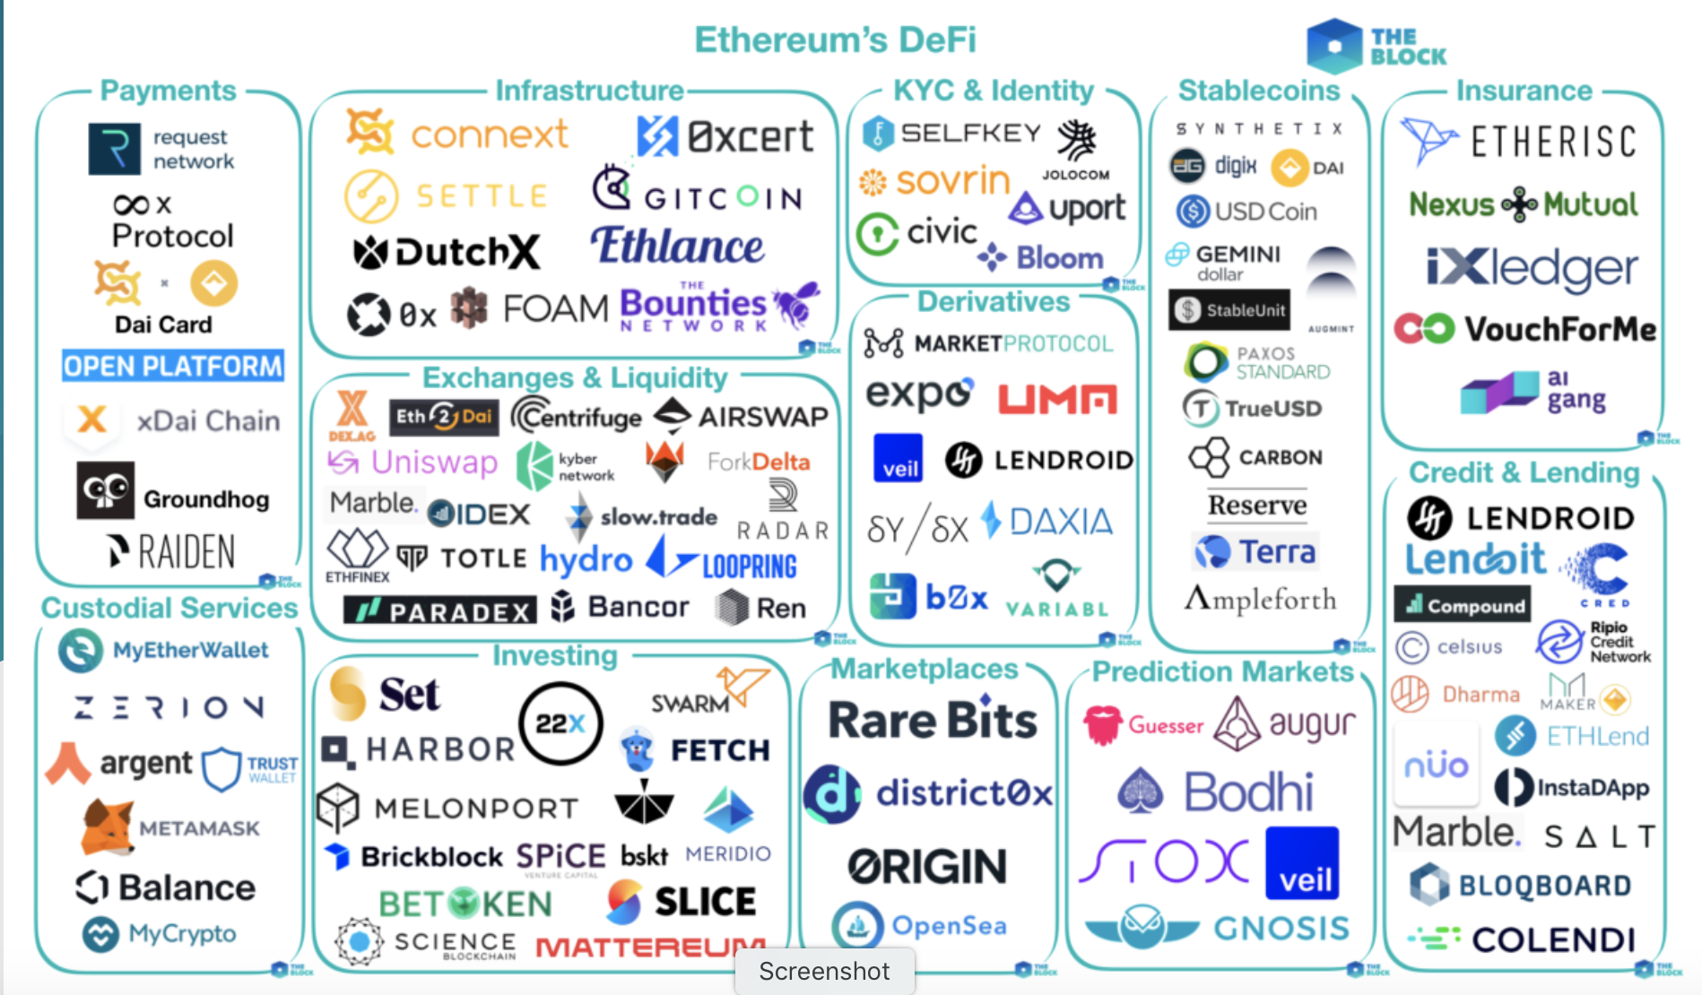
Lots of development:
[source: the Block Genesis]
Notes:
By the end of the course: you will know how to write your own DAPP.

Slide 26

This course
Cryptography
Distributed systems
Economics
Touches on the others

Slide 27
Course organization
The minimal cryptography for building Blockchains (Weeks 1-2)
Signatures, Hashes, Merkle Trees (Vector Commitments)
Consensus protocols (Weeks 3-6)
Aggregate Signatures, Verifiable Information Dispersal, Beacons, Light clients
Key Security and Threshold Crypto (Week 7)
Second part of course: The mysterious and wonderful world of ZK-SNARKs
Private Transactions (Zero-Knowledge)
Rollups (SNARKs)
Succinct Blockchains (Recursive Proofs)
Bridges
Additional topics: Post-quantum cryptography (Nick Spooner, week 11), Future crypto

Slide 28
Course organization
https://brightspace.nyu.edu/d2l/home/353819
4 Homework problem sets (First one up this week)
Final project: Either pairs or alone. Pick project by spring break
My office hours after class.
Arasu course assistant. Office hours:
Please tell us how we can improve … Don’t wait until the end of the quarter

Slide 29
Let’s get started …

Slide 30
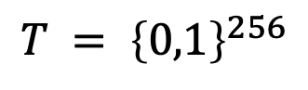
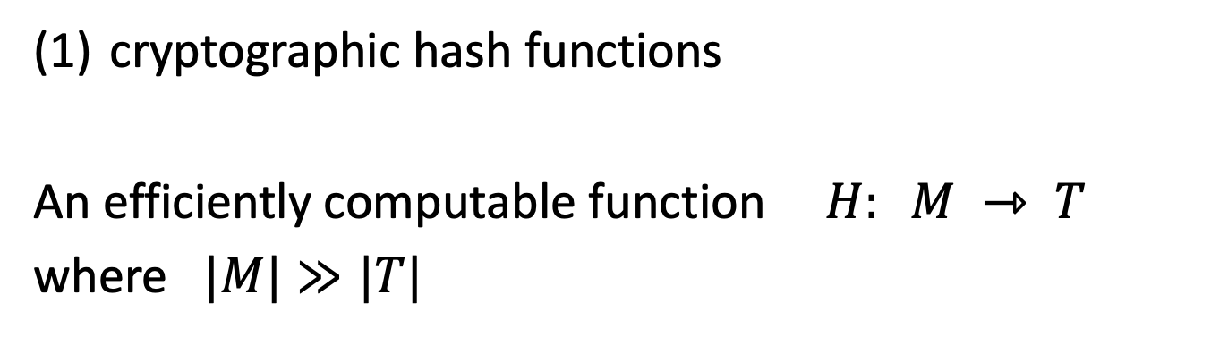
Hash Functions
cryptographic hash functions
An efficiently computable function $H: M ⇾ T$
where $|M|≫|T|$
32 bytes
megabytes
hash value
$$T = {\left\{0,1\right\}}^{256}$$

Slide 31
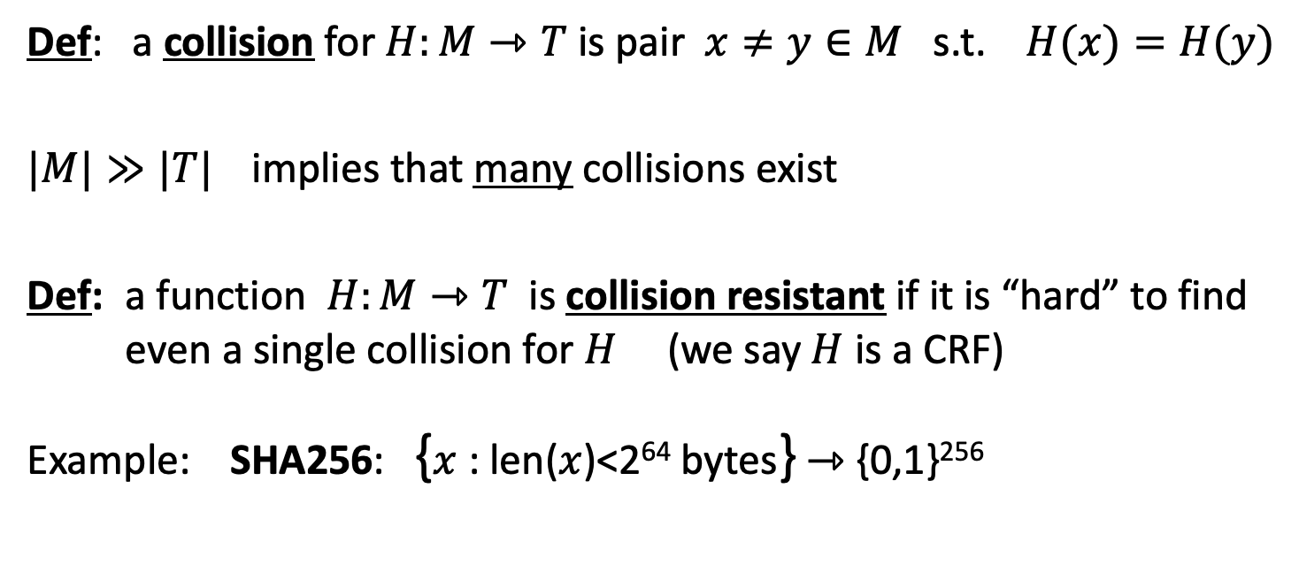
Collision resistance
Def: a collision for $H:M⇾T$ is pair $x≠y∈M$ s.t. $H(x)=H(y)$
$|M|≫|T|$implies that many collisions exist
Def: a function $H:M⇾T$ is collision resistant if it is “hard” to find even a single collision for $H$ (we say $H$ is a CRF)
Example: SHA256: {$x$ : len($x$)<2⁶⁴ bytes} ⇾ {0,1}²⁵⁶
(output is 32 bytes)

Slide 32
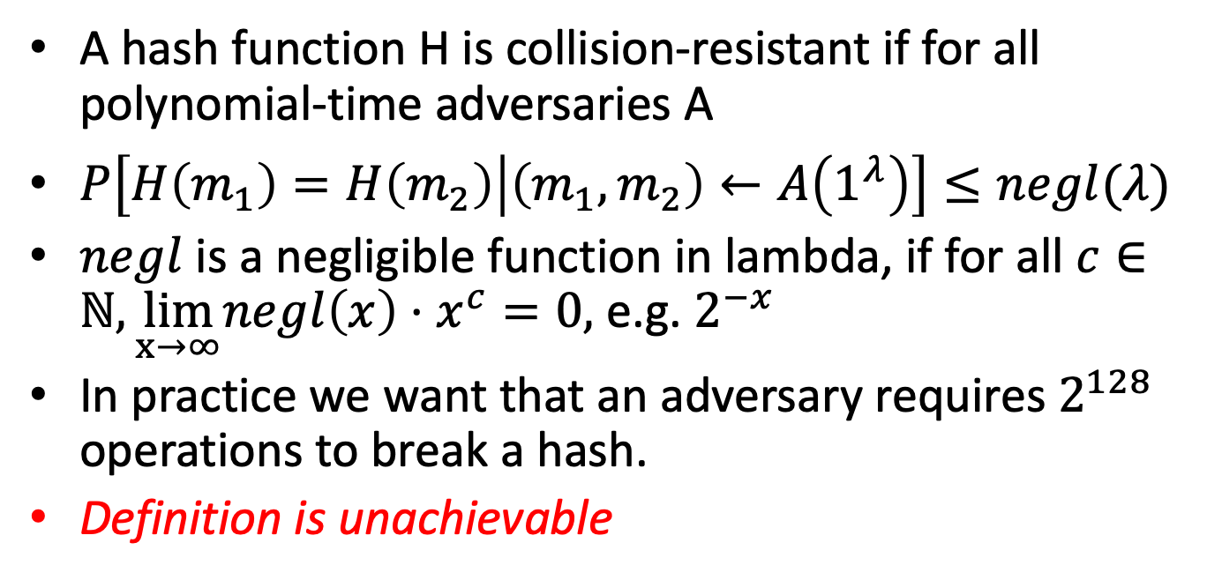
Collision Resistance Formally
A hash function H is collision-resistant if for all polynomial-time adversaries A
$P\left[H\left(m_{1}\right)=H\left(m_{2}\right) | \left(m_{1},m_{2}\right)←A\left(1^{λ}\right)\right]≤negl(λ)$
$negl$ is a negligible function in lambda, if for all $c∈ℕ,\lim_{x→∞}negl\left(x\right)⋅x^{c}=0,$ e.g. $2^{−x}$
In practice we want that an adversary requires $2^{128}$ operations to break a hash.
Definition is unachievable

Slide 33
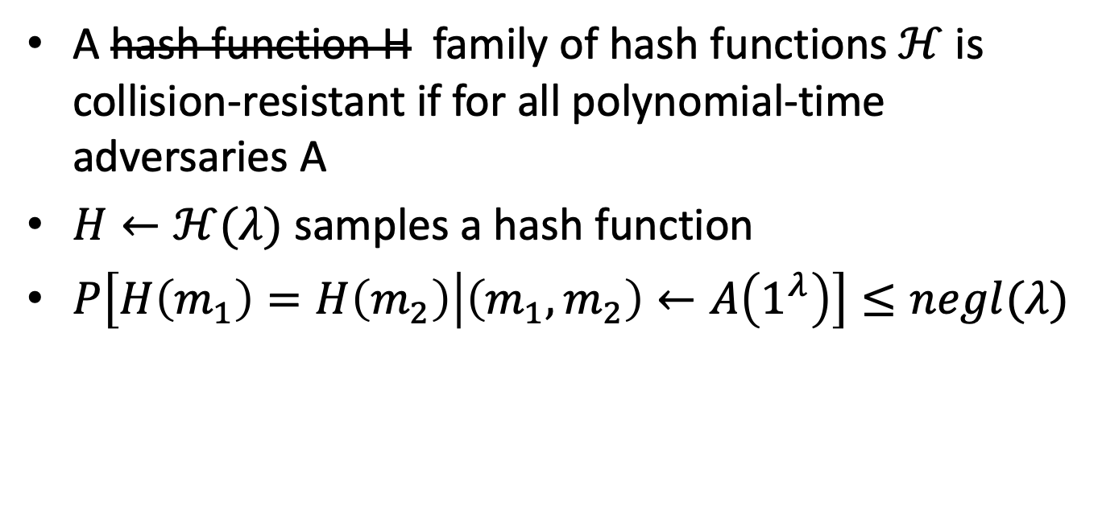
Collision Resistance Formally
A hash function H family of hash functions $ℋ$ is collision-resistant if for all polynomial-time adversaries A
$H←ℋ(λ)$ samples a hash function
$P\left[H\left(m_{1}\right)=H\left(m_{2}\right) | \left(m_{1},m_{2}\right)←A\left(1^{λ}\right)\right]≤negl(λ)$

Slide 34
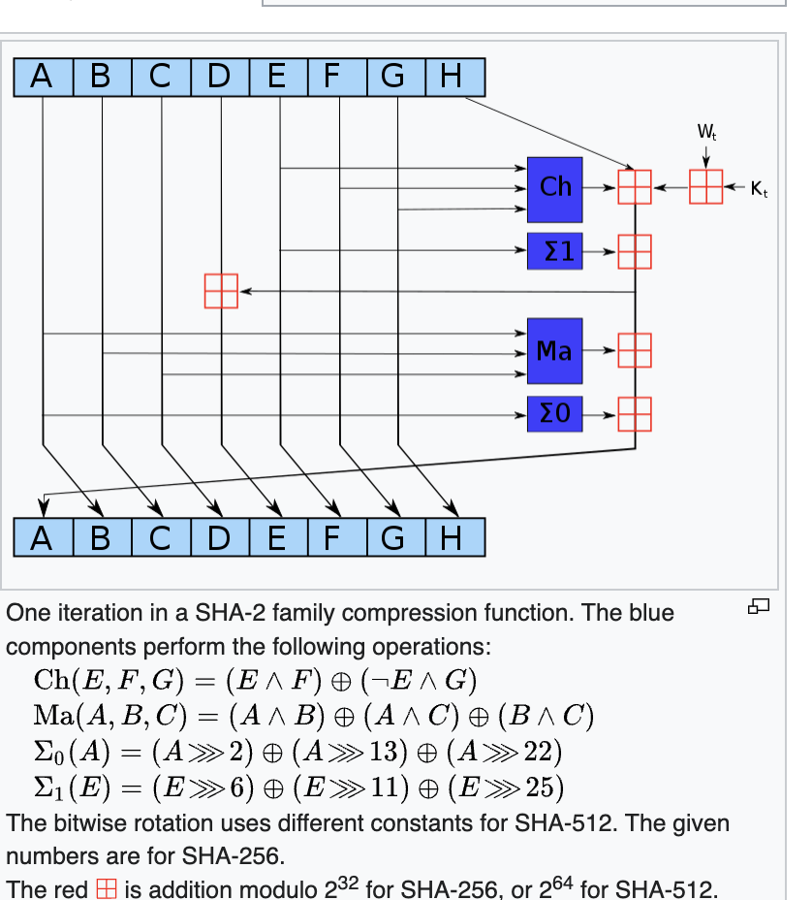
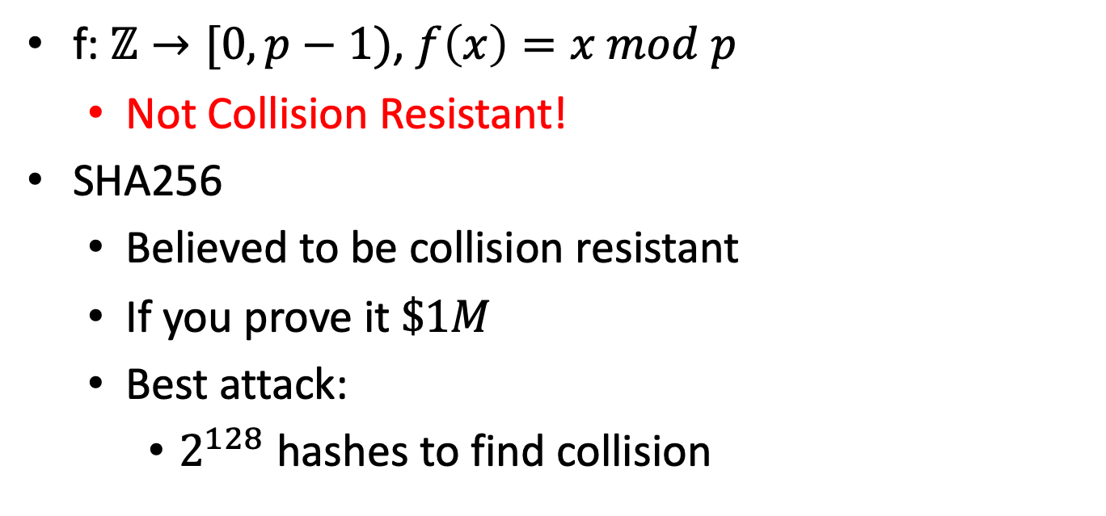
Example Hash function
f: $ℤ→[0,p−1)$, $f\left(x\right)=x mod p$
Not Collision Resistant!
SHA256
Believed to be collision resistant
If you prove it $\$1M$
Best attack:
$2^{128}$ hashes to find collision

Slide 35
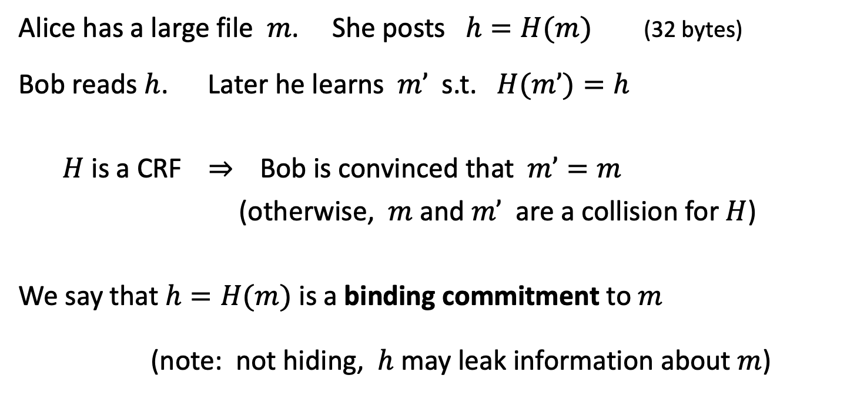
Application: committing to data on a blockchain
Alice has a large file $m$. She posts $h=H(m)$(32 bytes)
Bob reads $h$. Later he learns $m’$ s.t. $H(m’)=h$
$H$ is a CRF ⇒ Bob is convinced that $m’=m$
(otherwise, $m$ and $m’$ are a collision for $H$)
We say that $h=H(m)$ is a binding commitment to $m$
(note: not hiding, $h$ may leak information about $m$)
Notes:
Alice posts hash h on the blockchain.

Slide 36
Application: Connecting the Blockchain
Only 80 bytes
prev: H( )
prev: H( )
prev: H( )
Metadata
Metadata
Metadata
Metadata
trans: H( )
trans: H( )
trans: H( )
trans: H( )
Blocks are connected through hash pointers.
The head of the chain commits to entire history
But you can’t recover history from
transaction
transaction
transaction
transaction
Notes:
Alice posts hash h on the blockchain.

Slide 37
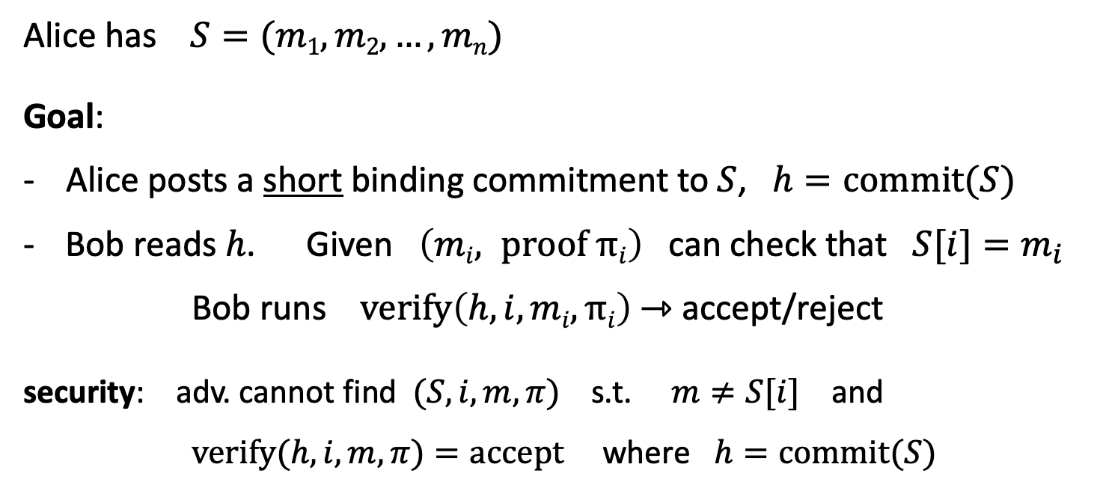
Committing to a list (of transactions)
32 bytes
Alice has $S=(m1,m2, …,mn)$
Goal:
- Alice posts a short binding commitment to $S$, $h=commit(S)$
Bob reads $h$. Given $\left(mi, proof πi\right)$ can check that $S[i]=m_{i}$
Bob runs $verify\left(h, i, mi, πi\right)$ ⇾ accept/reject
security: adv. cannot find $(S, i, m, π)$s.t. $m≠S[i]$ and $verify(h,i,m,π)=accept$where $h=commit(S)$

Slide 38
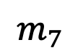
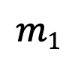
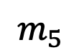

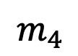
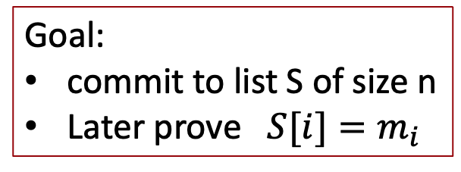
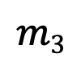
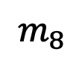
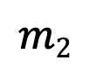
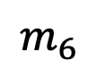
Merkle tree (Merkle 1989)
commitment
$$h$$
Goal:
commit to list S of size n
Later prove $S[i]=m_{i}$
Merkle tree commitment
$$m1$$
$$m2$$
$$m3$$
$$m_{4}$$
$$m_{5}$$
$$m_{6}$$
$$m_{7}$$
$$m_{8}$$
list of values S

Slide 39
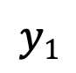
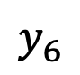
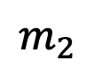
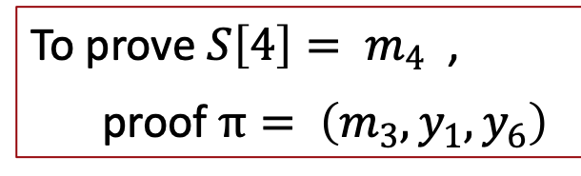
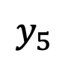
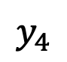
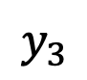

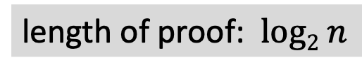
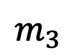
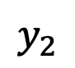
Merkle tree (Merkle 1989) [simplified]
commitment
$$h$$
Goal:
commit to list S of size n
Later prove $S[i]=m_{i}$
$$y_{5}$$
H
$$y_{6}$$
H
H
$$y1$$
$$y_{2}$$
$$y_{3}$$
$$y_{4}$$
To prove ${S\left[4\right]= m}_{4}$ ,
proof $π= \left(m_{3}, y_{1}, y_{6}\right)$
H
H
H
H
$$m1$$
$$m_{2}$$
$$m_{3}$$
$$m_{4}$$
$$m_{5}$$
$$m_{6}$$
$$m_{7}$$
$$m_{8}$$
length of proof: $log2 n$
list of values S

Slide 40
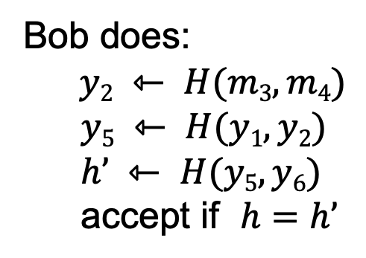
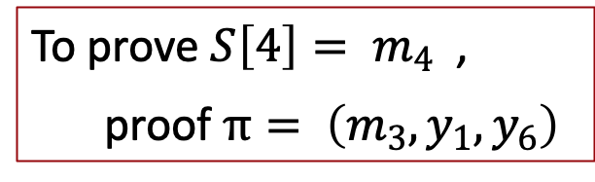
Merkle tree (Merkle 1989) [simplified]
commitment
$$h$$
To prove ${S\left[4\right]= m}_{4}$ ,
proof $π= \left(m_{3}, y_{1}, y_{6}\right)$
$$y_{5}$$
H
$$y_{6}$$
H
H
Bob does:
$y2 ⇽ H(m3,m4)$
$$y5 ⇽ H(y1, y2)$$
$$h’ ⇽ H(y5, y6)$$
accept if $h=h’$
$$y1$$
$$y_{2}$$
$$y_{3}$$
$$y_{4}$$
H
H
H
H
$$m1$$
$$m_{2}$$
$$m_{3}$$
$$m_{4}$$
$$m_{5}$$
$$m_{6}$$
$$m_{7}$$
$$m_{8}$$
list of values S

Slide 41
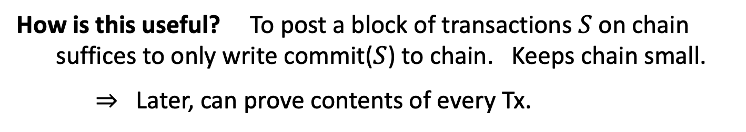
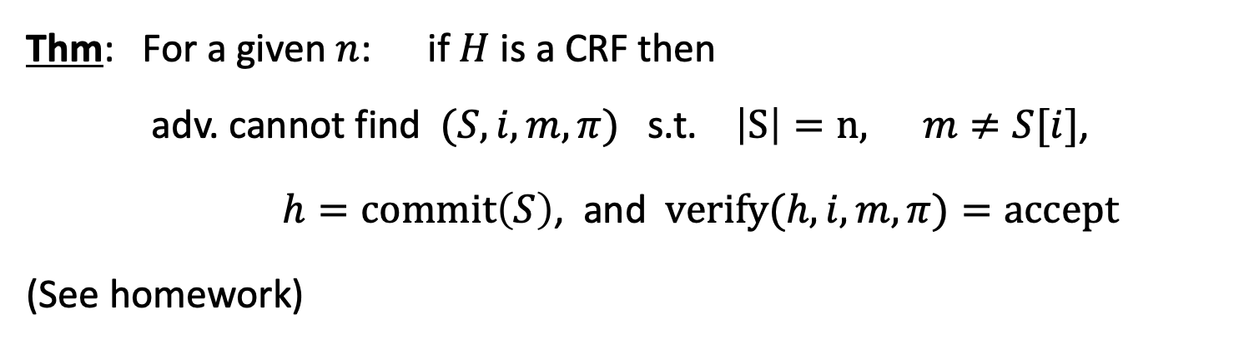
Merkle tree (Merkle 1989)
Thm: For a given $n$: if $H$ is a CRF then
adv. cannot find $(S, i, m, π)$s.t. $\left|S\right|=n,$ $m≠S[i]$,
$h=commit\left(S\right)$, and $verify(h,i,m,π)=accept$
(See homework)
How is this useful? To post a block of transactions $S$ on chain suffices to only write commit($S$) to chain. Keeps chain small.
⇒ Later, can prove contents of every Tx.

Slide 42
Abstract block chain
blockchain
block header
block header
block header
⊥
Merkle root
other data
hash
Merkle root
other data
hash
Merkle root
other data
Merkle tree
Merkle tree
Merkle tree
Tx₁ Tx₂ … Tx_{n}
Tx₁ Tx₂ … Tx_{n}
Tx₁ Tx₂ … Tx_{n}
Merkle proofs are used to prove that a Tx is “on the block chain”

Slide 43
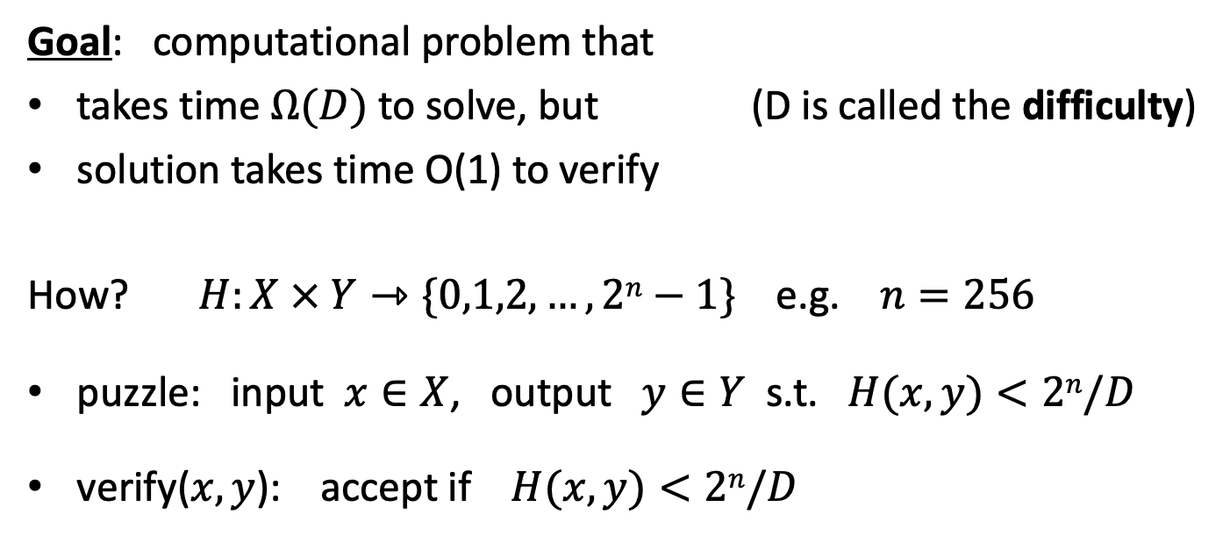
Another application: proof of work
Goal: computational problem that
takes time $Ω(D)$ to solve, but (D is called the difficulty)
solution takes time O(1) to verify
How? $H:X × Y⇾\{0,1,2,…,2n−1\}$ e.g. $n=256$
puzzle: input $x∈X$, output $y∈Y$ s.t. $H(x,y)<2n/D$
verify($x,y$): accept if $H(x,y)<2n/D$

Slide 44
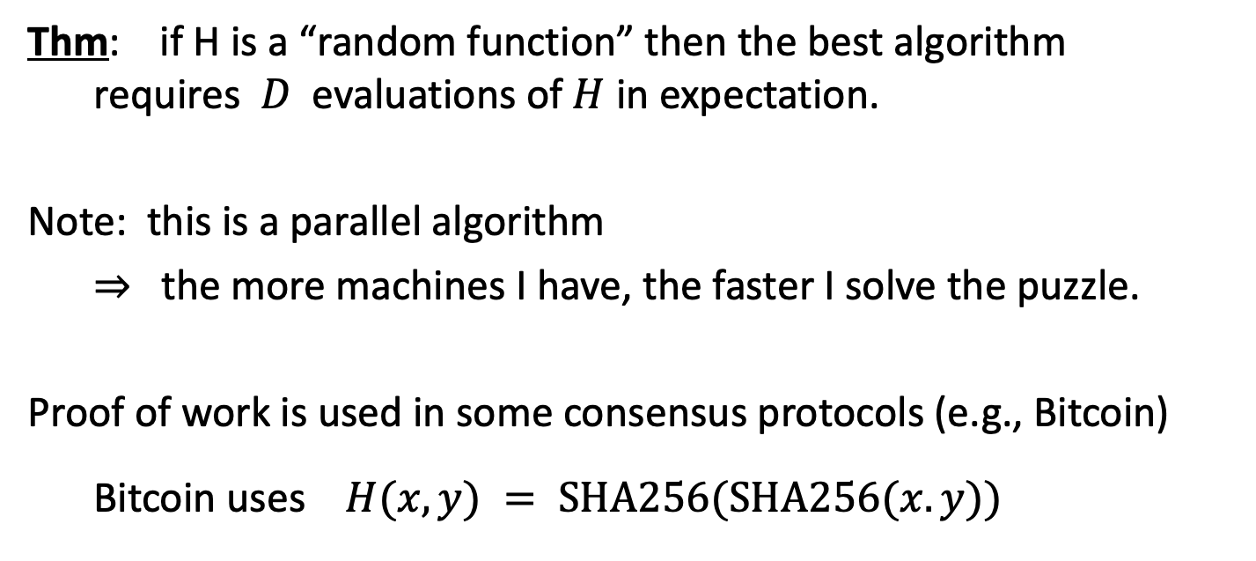
Another application: proof of work
Thm: if H is a “random function” then the best algorithm requires $D$ evaluations of $H$ in expectation.
Note: this is a parallel algorithm
⇒ the more machines I have, the faster I solve the puzzle.
Proof of work is used in some consensus protocols (e.g., Bitcoin)
Bitcoin uses $H(x,y) = SHA256(SHA256(x.y))$

Slide 45
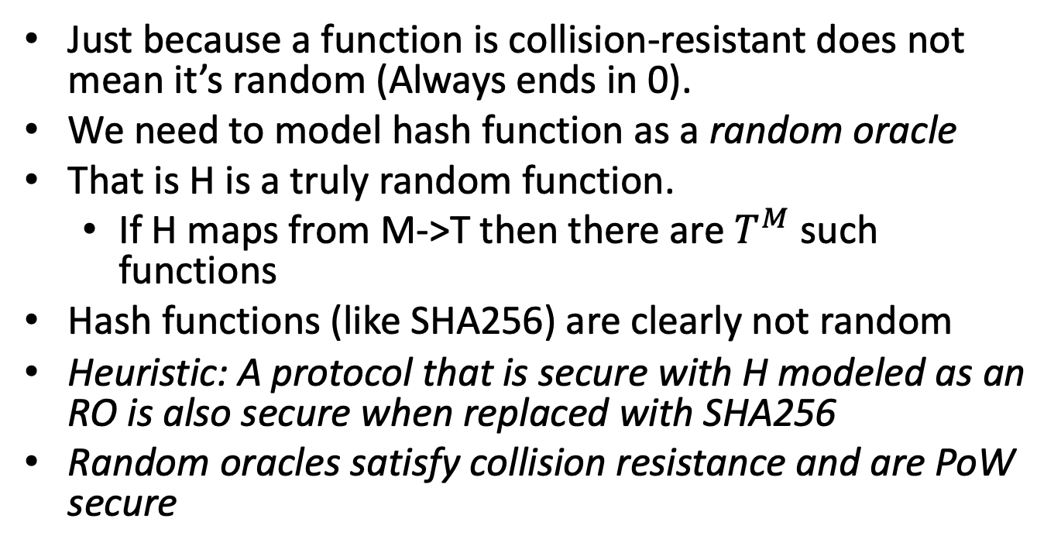
Collision resistance ≠ Random
Just because a function is collision-resistant does not mean it’s random (Always ends in 0).
We need to model hash function as a random oracle
That is H is a truly random function.
If H maps from M->T then there are $T^{M}$ such functions
Hash functions (like SHA256) are clearly not random
Heuristic: A protocol that is secure with H modeled as an RO is also secure when replaced with SHA256
Random oracles satisfy collision resistance and are PoW secure

Slide 46
Digital Signatures
How to authorize a transaction

Slide 47
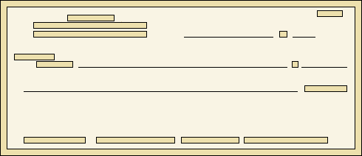
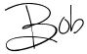
Signatures
Physical signatures: bind transaction to author
Bob agrees to pay Alice 1$
Bob agrees to pay Alice 100$
Problem in the digital world:
anyone can copy Bob’s signature from one doc to another
Notes:
Bad example: will see why on the last slide of this segment.

Slide 48
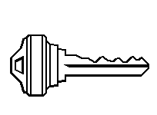

Digital signatures
Solution: make signature depend on document
Signer
Verifier
‘accept’
or
‘reject’
Bob agrees to pay Alice 1$
verifier
signature
signing
algorithm
secret signing key (sk)
public verification key (pk)

Slide 49
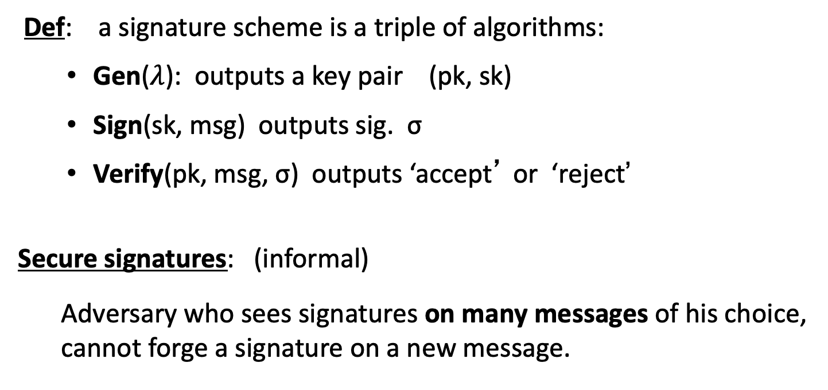
Digital signatures: syntax
Def: a signature scheme is a triple of algorithms:
Gen($λ$): outputs a key pair (pk, sk)
Sign(sk, msg) outputs sig. σ
Verify(pk, msg, σ) outputs ‘accept’ or ‘reject’
Secure signatures: (informal)
Adversary who sees signatures on many messages of his choice, cannot forge a signature on a new message.

Slide 50
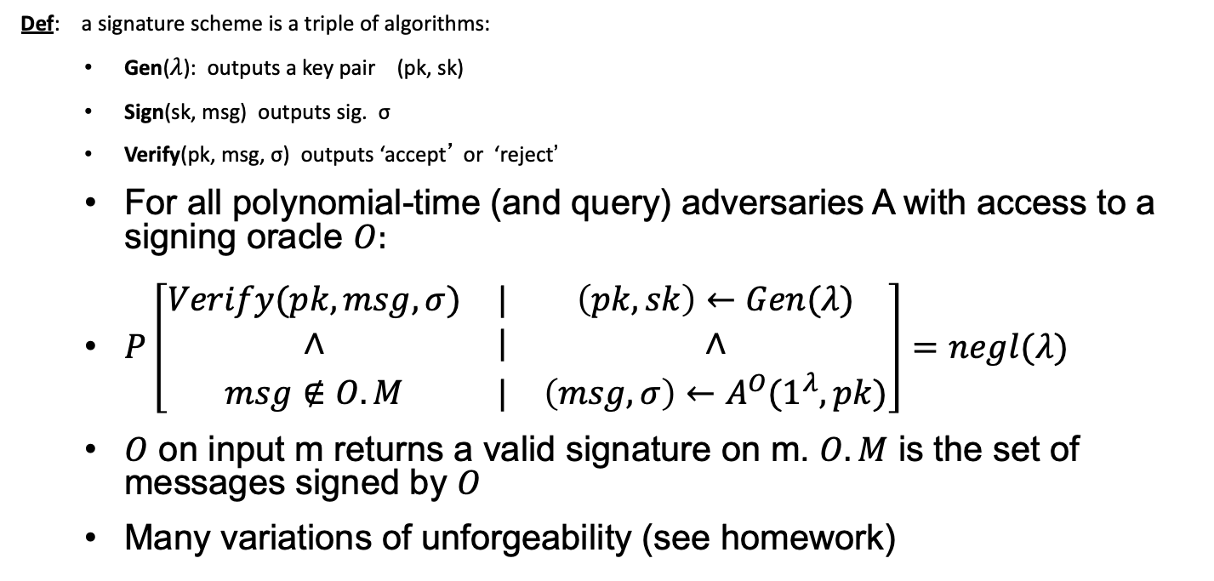
Unforgeability
Def: a signature scheme is a triple of algorithms:
Gen($λ$): outputs a key pair (pk, sk)
Sign(sk, msg) outputs sig. σ
Verify(pk, msg, σ) outputs ‘accept’ or ‘reject’
For all polynomial-time (and query) adversaries A with access to a signing oracle $O:$
$P\left[\begin{matrix}Verify(pk,msg,σ) & | & \left(pk,sk\right)←Gen(λ) \\ ∧ & | & ∧ \\ msg∉O.M & | & \left(msg,σ\right)←A^{O}(1^{λ},pk)\end{matrix}\right]=negl(λ)$
$O$ on input m returns a valid signature on m. $O.M$ is the set of messages signed by $O$
Many variations of unforgeability (see homework)

Slide 51
Signatures on the blockchain
Signatures are used everywhere:
ensure Tx authorization,
governance votes,
consensus protocol votes.
verifyTx
verifyTx
verify Tx
sk₁
data
signatures
sk₂
data
signatures

Slide 52
Families of signature schemes
RSA signatures (old … not used in blockchains):
long sigs and public keys (≥256 bytes), fast to verify
Discrete-log signatures: Schnorr and ECDSA
short sigs (48 or 64 bytes) and public key (32 bytes)
BLS signatures: 48 bytes sigs, aggregatable, easy threshold
Post-quantum signatures: long (≥600 bytes) (Later in class)
(Bitcoin, Ethereum)
(Ethereum PoS, Chia, Dfinity)

Slide 53
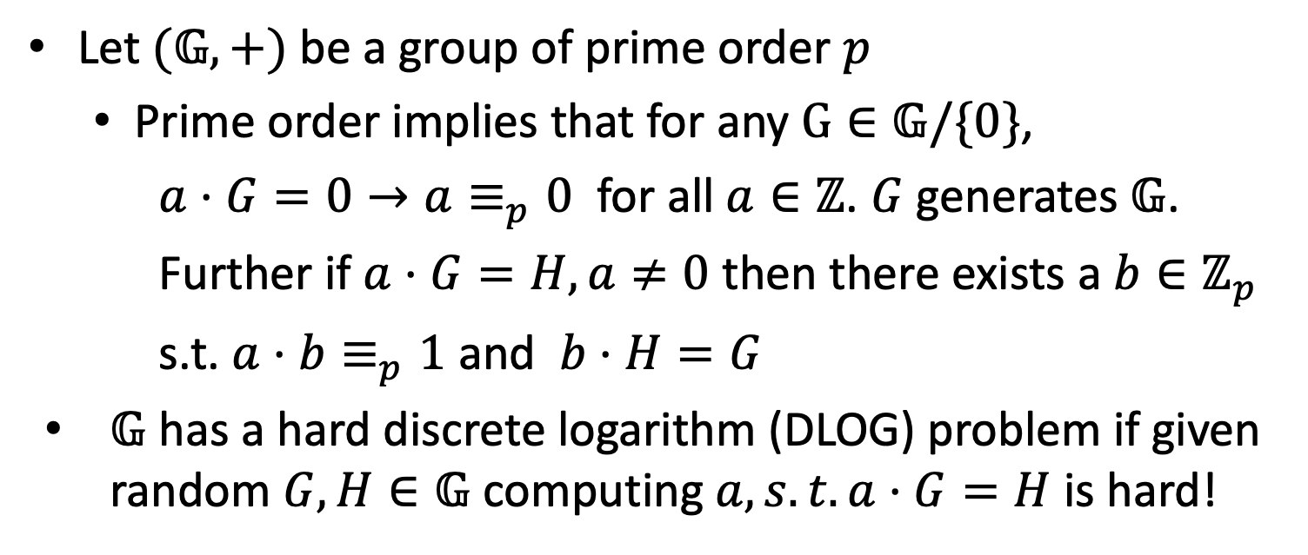
Schnorr signature
Let $(𝔾,+)$ be a group of prime order $p$
Prime order implies that for any $G∈𝔾/\{0\}$,
$a⋅G=0→a≡_{p}0$ for all $a∈ℤ$. $G$ generates $𝔾$.
Further if $a⋅G=H,a≠0$ then there exists a $b∈ℤ_{p}$
s.t. $a⋅b≡_{p}1$ and $b⋅H=G$
$𝔾$ has a hard discrete logarithm (DLOG) problem if given random $G,H∈𝔾$ computing $a, s.t. a⋅G=H$ is hard!

Slide 54

Schnorr signature
$𝔾$ group of order p with hard DLOG, G random generator of $𝔾$. H a hash function from ${\left\{0,1\right\}}^{∗}→$ $ℤ_{p}$
Gen($λ$)$:𝔾$ group of order p with hard DLOG, G
$sk←^{\$}ℤ_{p},pk←sk⋅G∈𝔾$
Sign ($sk,msg$):
$r←^{\$}ℤ_{p}, R←r⋅G∈𝔾$
$c←H\left(R,pk,msg\right)$ (challenge), $s←r+c⋅sk$
Output $σ=(R,s)$
Verify($pk,msg,σ=(R,s)):$
$c←H\left(R,pk,msg\right), s⋅G=R+c⋅pk$

Slide 55

Schnorr security
Intuition (part 1):
Assume we had valid signatures on two messages that somehow used the same R: (R,s) and (R,s’).
Then $c←H(R,pk,msg)$ and $c^{′}←H(R,pk,msg^{′})$ are distinct with high probability (H is random)
$s⋅G=R+c⋅pk$ and $s^{′}⋅G=R+c^{′}⋅pk$
Subtract them and get $\left(s−s^{′}\right)⋅G=\left(c−c^{′}\right)⋅pk$
$\frac{\left(s−s^{′}\right)}{c−c^{′}}=sk$. Signer must know sk

Slide 56

Schnorr security
$s⋅G=R+c⋅pk$
Intuition (part 2):
Signer must “know” sk
However what if $σ$ reveals $sk$
Note I could also make the signature $s,c$ as
$R=s⋅G−c⋅pk$
But $c$ is completely random and independent of sk (Random oracle).
So is $s=r+c⋅sk$ as $r$ is random and independent of sk!
The signature is independent of the secret key but still the signer must know sk in order to produce signatures
Seems contradictory (much more on this later)

Slide 57

Schnorr security
$pk←sk⋅G∈𝔾$
Intuition (part 3)
For signing the signer must know sk
An adversary can learn no information from observed signatures (unless somehow the same R is used twice which is unlikely)
So a forging adversary must recover sk from pk
Hard because that requires computing discrete logarithms!

Slide 58

Pairings
Assume group $𝔾$ has a so called pairing
$e:𝔾×𝔾→𝔾_{T}$ is a bilinear map:
$e\left(G_{1}+G_{2},H\right)=e\left(G_{1},H\right)+e(G_{2},H)$
$e\left(G,H_{1}+H_{2}\right)=e\left(G,H_{1}\right)+e(G,H_{2})$
$𝔾,𝔾_{T}$ are prime order groups of order p
Implies $e\left(a⋅G,b⋅H\right)=a⋅b⋅e(G,H)$

Slide 59

BLS signature
Assume group $𝔾$ has a so called pairing
Let H be a hash function that maps to $𝔾$ (modeled as RO)
Gen($λ$)$:𝔾$ group of order p with hard DLOG, G
$sk←^{\$}ℤ_{p},pk←sk⋅G∈𝔾$
Sign ($sk,msg$):
Output $σ=sk⋅H(msg)$ //Only one element in $𝔾$
Verify($pk,msg,σ∈𝔾)$
$e\left(σ,G\right)=$ $e\left(H\left(msg\right),pk\right)$
$$e\left(sk⋅H(msg),G\right)=e\left(H\left(msg\right),sk⋅G\right)=sk⋅e(H\left(msg\right),G)$$

Slide 60
END OF LECTURE
Next lecture: More on Merkle Trees and Accumulators

